Slide 1
Sprint 5

Slide 2
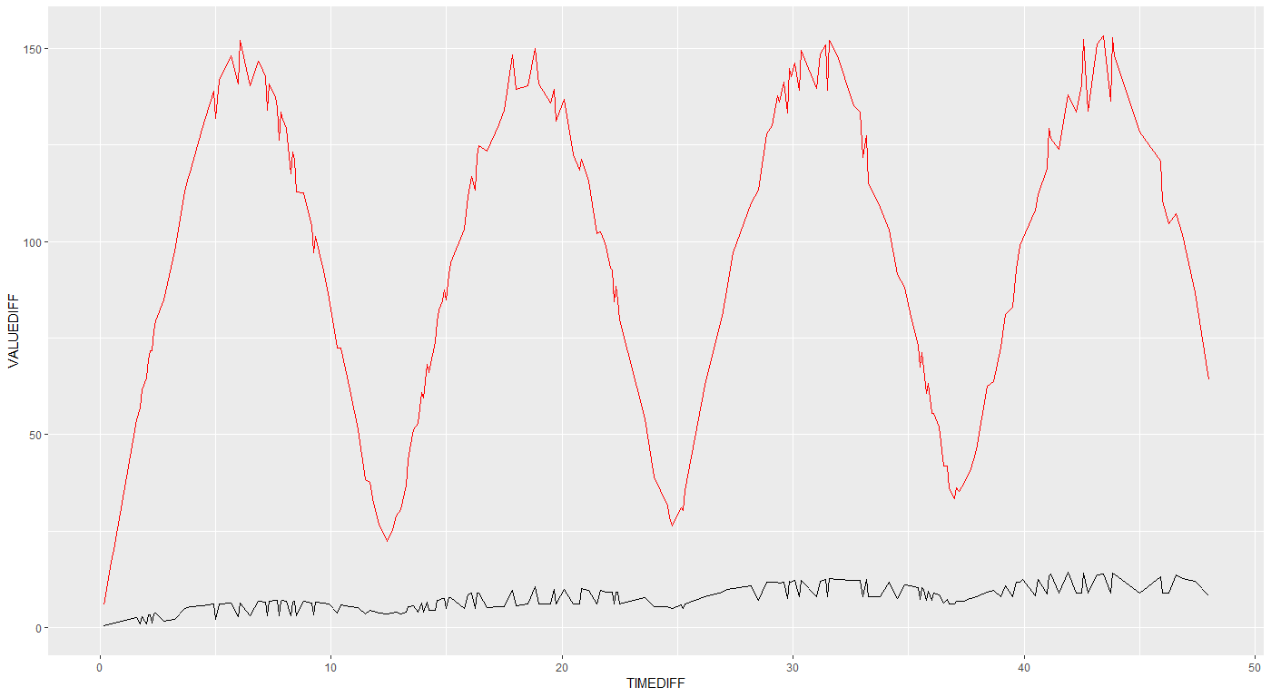

Slide 3
Why not subsample intervals?
In case of very large intervals (e.g. month): only a few samples
Subsampling:
Intuitively: not how a real logger works.
Independence assumption: does not work in case of subsampling.

Slide 4
Nice thing about this method is that it don't require equidistant time differences (because our apriori knowledge)
E.g.: you measure each 5 min, and then suddenly you don’t measure for 2 days. Suddenly you have a level shift. How likely is this level shift, given apriori data?

Slide 5
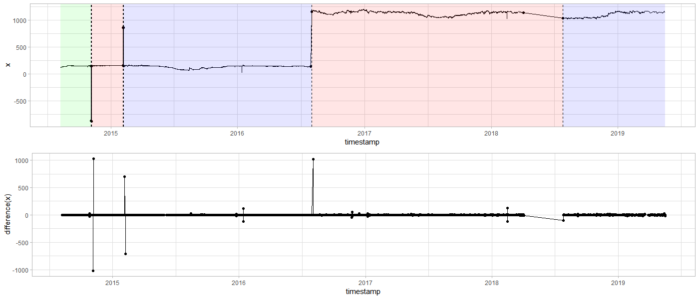
DYLP023A_S3804
Notes:
Levelshifts voorbeelden.

Slide 6
DYLP023A_S3804
tsdiff lower.bound upper.bound mu sigma2 n.dens c
1: 60 -1.570154 1.920188 0.0028163680 0.2249896 1740 5.131617
2: 3600 -41.500000 75.950000 0.0007904937 176.5041630 42216 5.533473
3: 7200 -79.300000 119.400000 -0.0027705359 624.2812076 21099 3.934556
4: 10800 -114.800000 149.900000 0.0012843477 1201.9183258 14062 5.319899
5: 14340 -135.800000 172.500000 -0.0113069111 1776.2416541 10539 3.480756
6: 14400 -135.800000 172.500000 -0.0113069111 1776.2416541 10539 4.916277
7: 18000 -160.700000 183.200000 -0.0116379456 2209.1637351 8431 3.480756
8: 21600 -172.900000 182.642000 0.0178145161 2415.4158909 7022 4.928644
9: 28800 -175.350000 150.500000 0.0536567608 1978.0713512 5263 3.662228
10: 43200 -52.909000 57.575000 0.0728922136 92.0281735 3502 4.326421
11: 64800 -174.100000 185.967000 0.1895978406 2391.7663740 2331 3.934556
12: 79200 -126.583000 112.408000 0.1101327626 1151.9654904 1902 3.480756
13: 86400 -88.000000 66.100000 0.1127067962 232.2502910 1741 4.403723
14: 129600 -89.075000 80.616000 0.2844741379 401.5038693 1160 3.480756
15: 140400 -87.033000 117.192000 0.0360796626 674.4104766 1067 3.480756
16: 151200 -152.250000 201.075000 0.0961515152 2248.8092710 990 3.480756
17: 172800 -102.700000 95.900000 0.3474837963 634.1676031 864 3.480756
18: 194400 -154.816000 205.508000 0.0083007813 2088.9459283 768 3.480756
19: 259200 -138.425000 144.800000 0.2899842105 1107.9036127 570 3.662228
20: 320400 -121.500000 125.359000 0.2672056277 972.7287087 462 3.480756
21: 324000 -131.716000 141.517000 0.0477577093 1334.0424222 454 3.480756
22: 406800 -124.500000 86.333000 0.1733130194 596.4732466 361 3.480756
23: 604800 -176.750000 186.958000 1.2400677966 2365.6598563 236 3.480756
24: 864000 -150.200000 131.500000 2.0432787879 2330.1821575 165 3.480756
25: 9882000 -52.900000 23.000000 0.0250000000 1269.8025000 4 3.480756
tsdiff lower.bound upper.bound mu sigma2 n.dens c

Slide 7
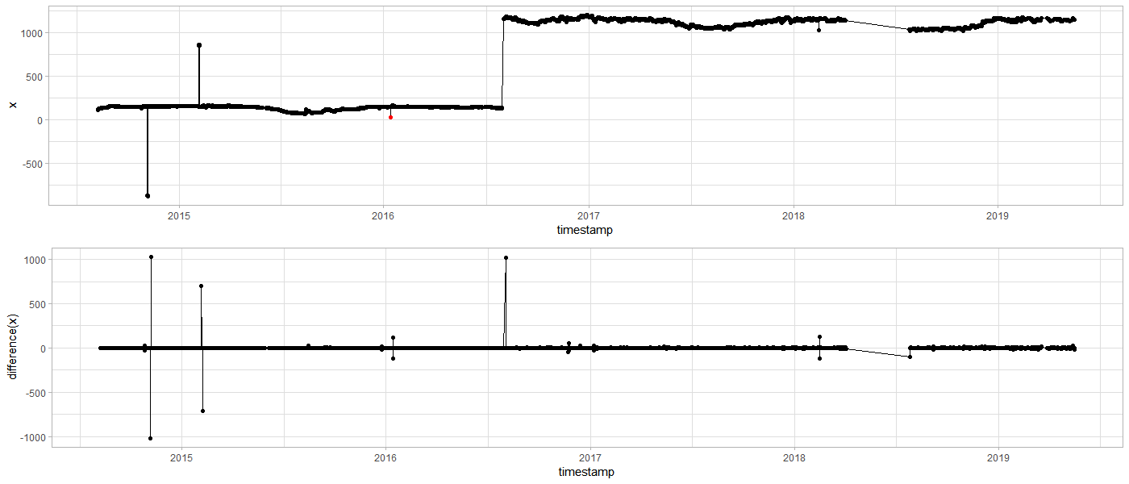
DYLP023A_S3804
Notes:
Ene outlier werd gedetecteerd, maar andere niet. Reden zit in time differences.

Slide 8
DYLP023A_S3804
tsdiff vdiff lower.bound upper.bound mu sigma2 n.dens c outlier
3600 -119.1260886 -41.5 75.9 0.000790494 176.504 42216 5.533473 TRUE
3600 118.8260229 -41.5 75.9 0.000790494 176.504 42216 5.533473 TRUE
14400 -116.9593409 -135.8 172.5 -0.011306911 1776.242 10539 4.916277 FALSE
10800 122.2678611 -114.8 149.9 0.001284348 1201.918 14062 5.319899 FALSE
Notes:
Hier is te zien dat er bij de eerste timediff 1u is, terwijl bij 2e om een langere periode gaat.

Slide 9
Advantages
Full control:
performance
reasons why something is detected as is

Slide 10
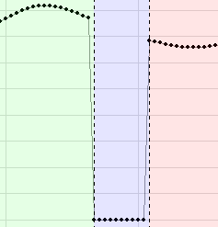
Geotech v0.05

Slide 11
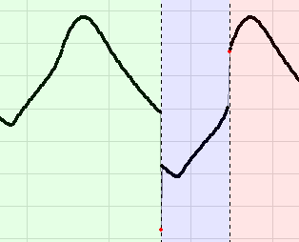
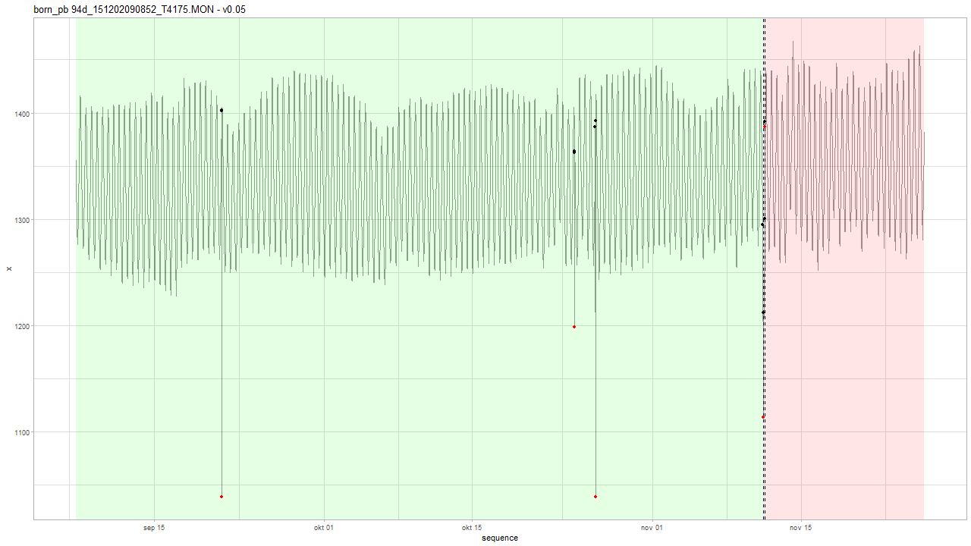
Geotech v0.05

Slide 12
Geotech: v0.05 vs. v0.06
Only differences in
born_pb 94d_151202090852_T4175.MON
born_pb 94d_160317114145_T4175.MON
born_pb 112d_151202090850_T4180.MON
pp09-1_120829130801_F5474.MON

Slide 13
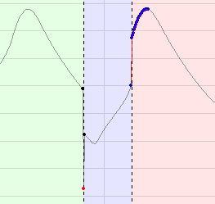
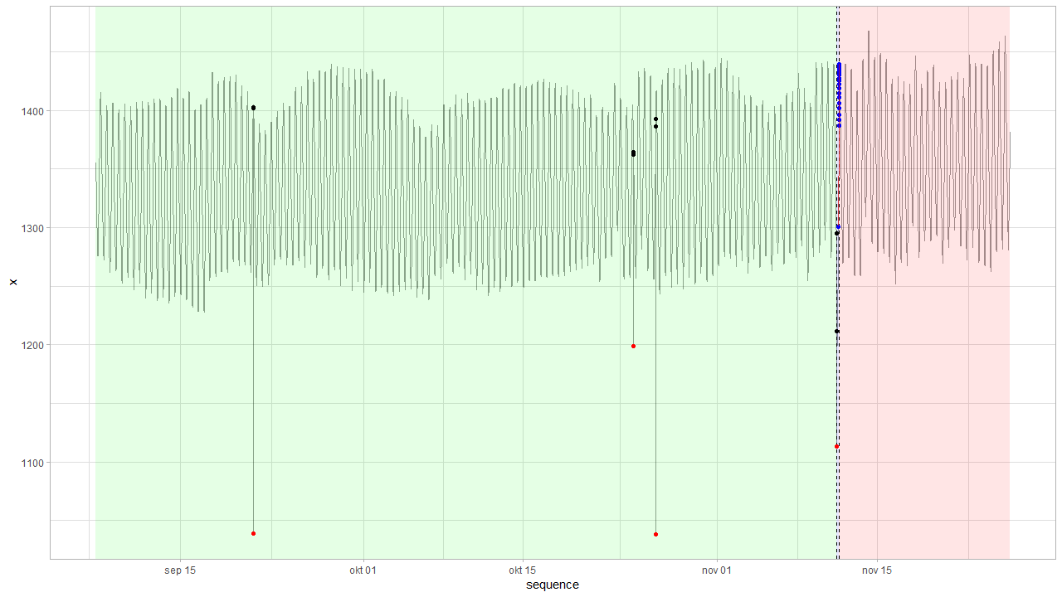
Geotech: v0.06 vs. v0.05 born_pb 94d_151202090852_T4175.MON
V0.06
Notes:
type index alpha delta
1: AO 3968 -363.44550 NA
2: AO 13555 -164.79150 NA
3: AO 14117 -351.28300 NA
4: AO 18671 -98.52490 NA
5: LS 18671 -83.12519 NA
6: LS 18731 141.76297 NA
7: TC 18731 -55.43006 0.88835

Slide 14
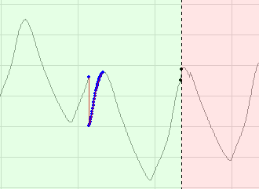
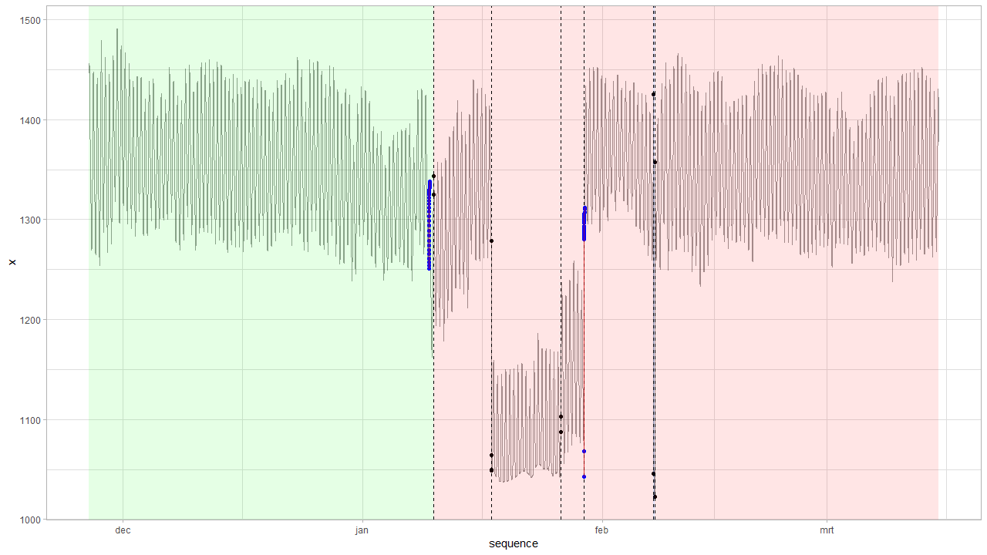
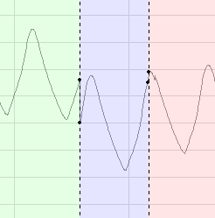
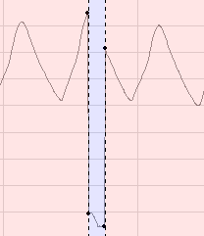
Geotech: v0.06 vs. v0.05 born_pb 94d_160317114145_T4175.MON
V0.06 (Wrong)
V0.05 (Correct)
Notes:
type index alpha delta
1: TC 12646 -78.75362 0.9
2: LS 12819 18.66690 NA
3: LS 14964 -229.19110 NA
4: LS 14967 15.28390 NA
5: LS 17548 14.99090 NA
6: LS 18423 234.68931 NA
7: TC 18422 -26.10584 0.9
8: LS 21015 -379.05010 NA
9: LS 21051 334.48390 NA

Slide 15
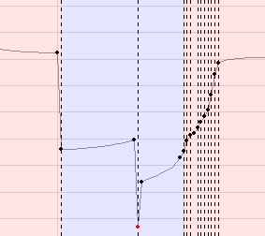
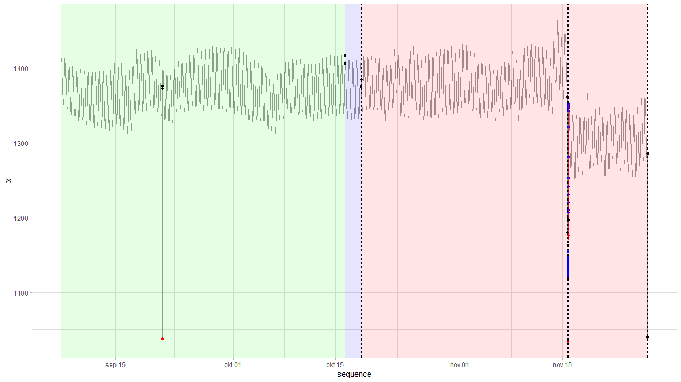
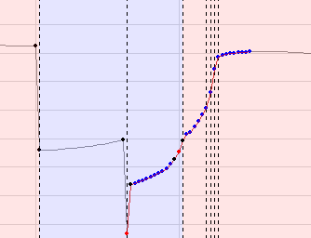
Geotech: v0.06 vs. v0.05 born_pb 112d_151202090850_T4180.MON
V0.05
V0.06
Notes:
type index alpha delta
1: AO 3966 -336.291000 NA
2: LS 11151 -10.675097 NA
3: LS 11785 10.032903 NA
4: LS 19886 -182.234182 NA
5: AO 19908 -135.556366 NA
6: LS 19908 -28.647396 NA
7: LS 19930 35.651662 NA
8: LS 19929 24.020522 NA
9: LS 19931 18.204817 NA
10: LS 19922 98.079984 NA
11: TC 19922 -68.068404 0.861789
12: AO 19921 11.545716 NA
13: TC 19909 -49.970933 0.900000
14: LS 19928 7.035651 NA
15: LS 23049 -245.934097 NA

Slide 16
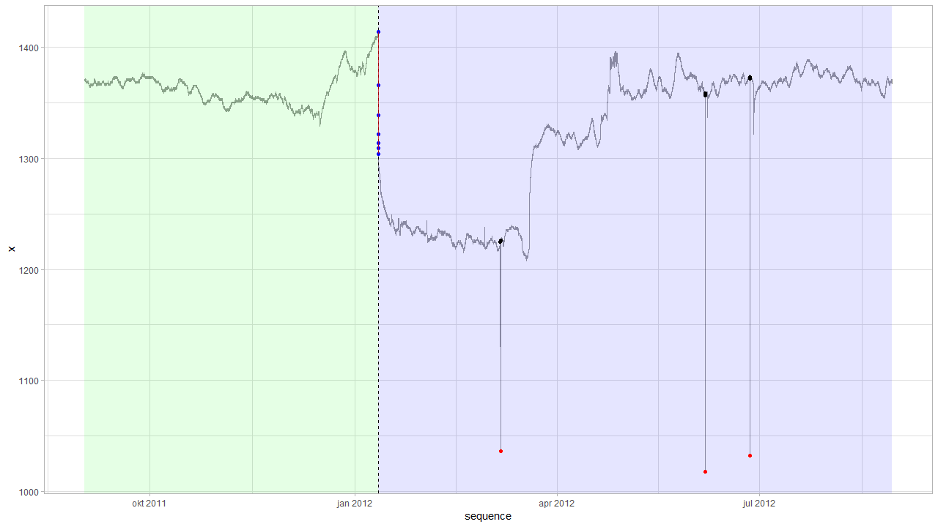
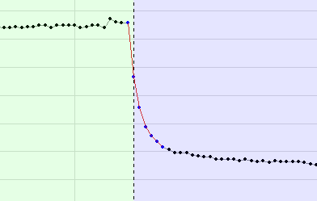
Geotech: v0.06 vs. v0.05 pp09-1_120829130801_F5474.MON
V0.06
Notes:
type index alpha delta
1: LS 12667 -115.47090 NA
2: TC 12667 67.47053 0.600487
3: AO 17938 -189.50000 NA
4: AO 26767 -340.00000 NA
5: AO 28706 -340.50000 NA

Slide 17
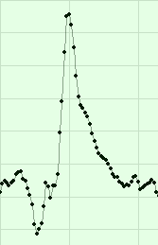
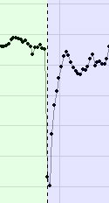
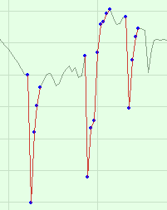
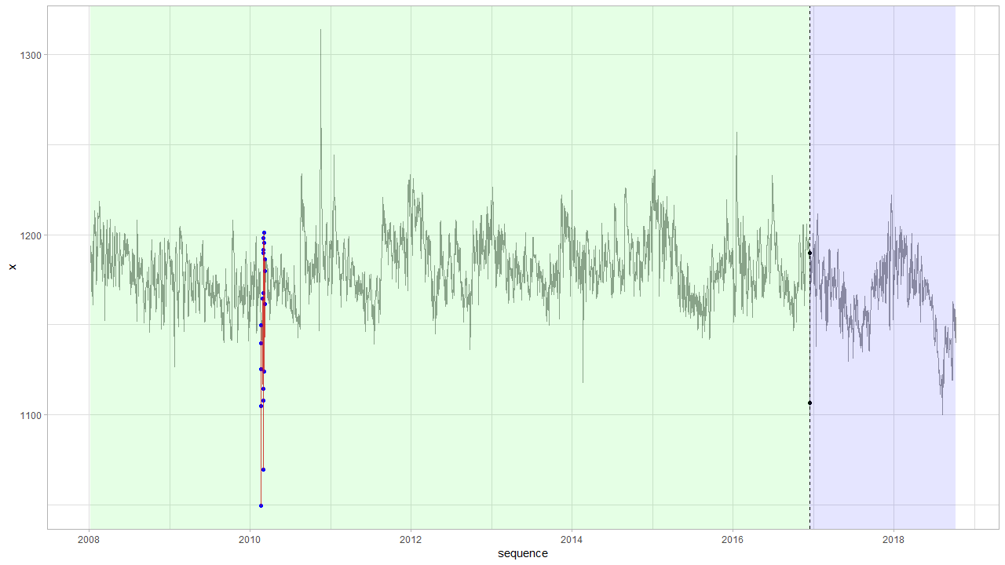
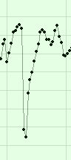
DYLP085A_80769
Notes:
Voor de 3e case: hangt allemaal af waar je uw treholds voor diff-outliers zet…

Slide 18
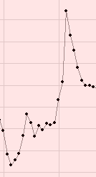
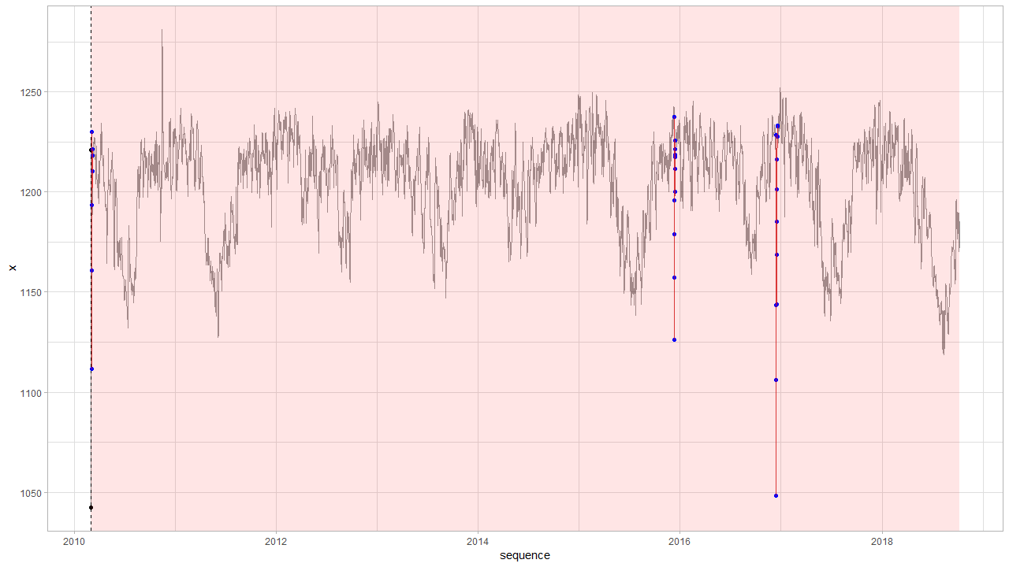
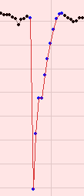
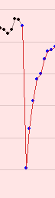
DYLP108A_D7570

Slide 19
Sprint 4
Documentation and diagnostic plots

Slide 20
Agenda
Documentation
Diagnostic plots (outliers)
Air pressure: clean a-priori data
Universal data loading
Geotech data
Comparison outlier detection: v0.04 vs. tsoutliers
Next steps

Slide 21
Documentation
Vignette

Slide 22
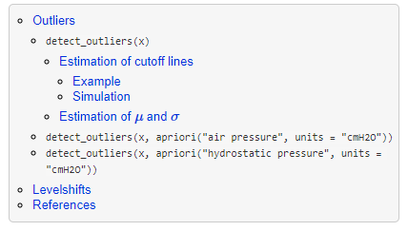
Documentation
Vignette TOC
2 main parts:
Vignette
API interface
Goal: pkgdown-like documentation
Website-like documentation
Supported by github

Slide 23
Diagnostic plots
Outliers

Slide 24
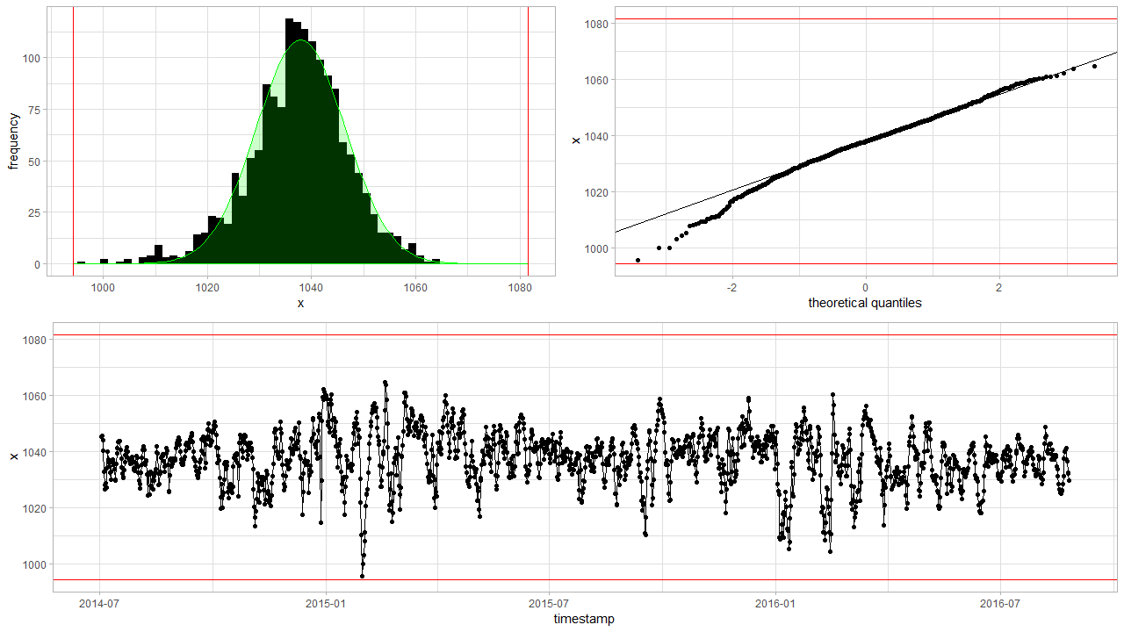
Diagnostic plots detect_outliers(x, plot = TRUE)

Slide 25
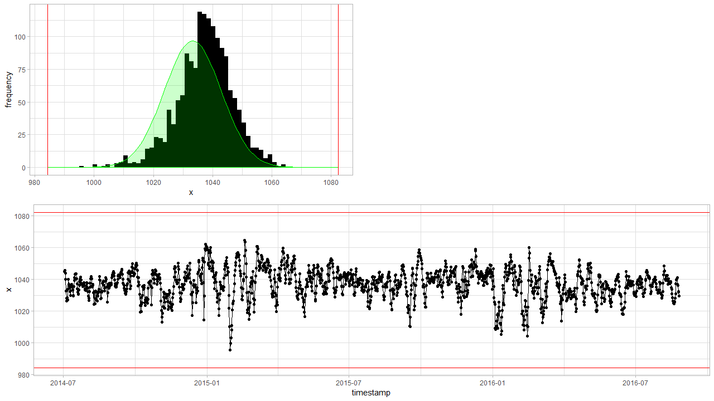
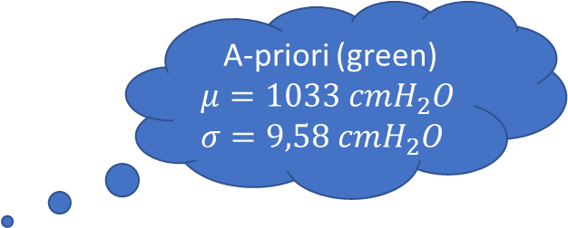
Diagnostic plots detect_outliers(x, apriori(“air pressure”) , plot = TRUE)
A-priori (green)
$$μ=1033 cmH_{2}O$$
$$σ=9,58 cmH_{2}O$$
Notes:
Based on new data

Slide 26
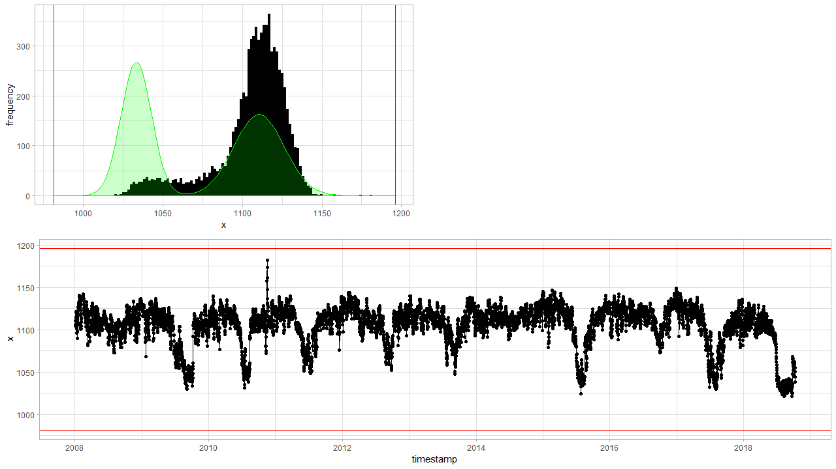
Diagnostic plots detect_outliers(x, apriori(“hydrostatic pressure”) , plot = TRUE)
Notes:
Based on new data

Slide 27
Air pressure
Clean a-priori data

Slide 28
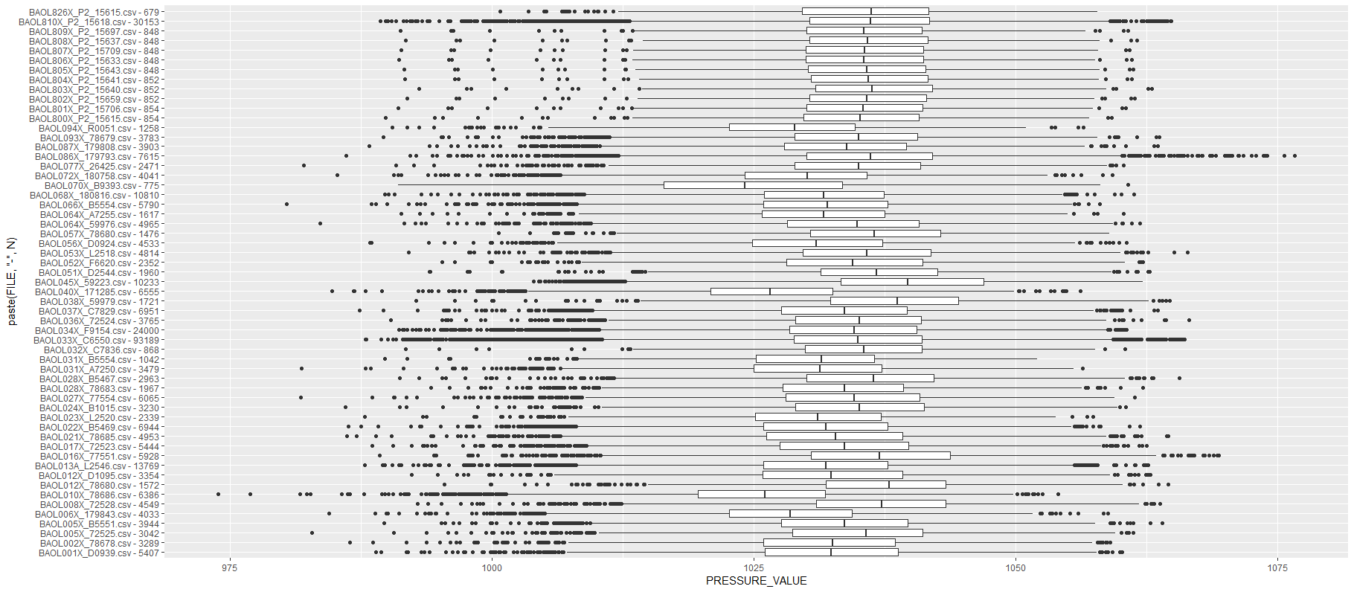
Air pressure: clean a-priori data
Notes:
Aggregated by day --> Some data is is high frequency (like BAOL033X) which has 20x or more datapoints than others, and thus has a higher weight on the distribution.
Are BAOL040X and BAOL010X and BAOL094X from the same region? And BAOL070X? This latter might be amplifying the left skewness.
Only data with a timestamp is taken into consideration.

Slide 29
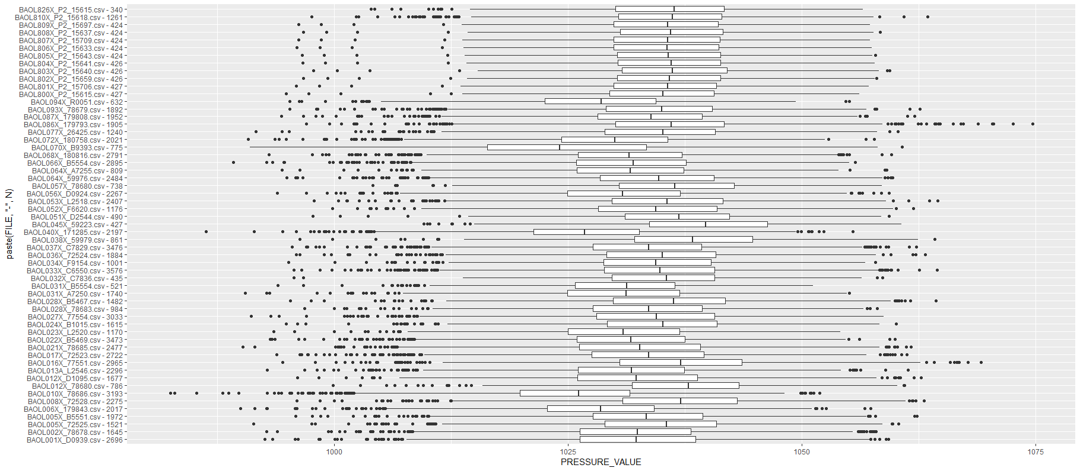
Air pressure: aggregated clean a-priori data

Slide 30
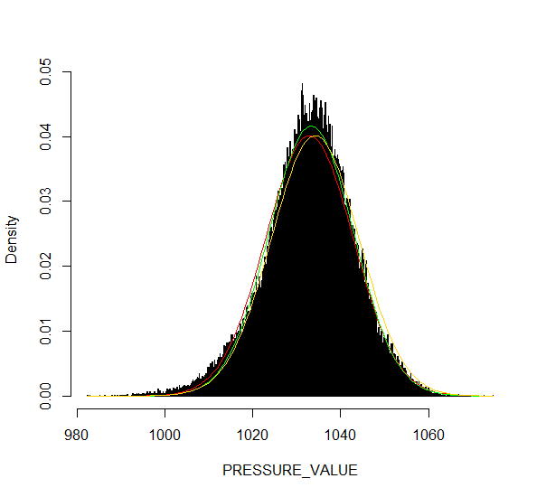
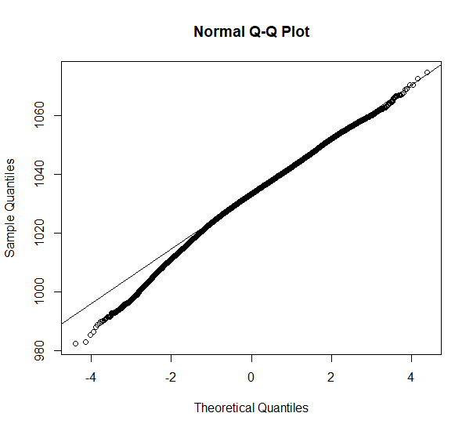
Comparison: apriori air pressure red (sd/mean), green (robust), yellow (robust old data)
A-priori pressure data is as good as it can get…
Notes:
The green curve s the robust estimate for in v0.02 (mean = 1033.317 // sd = 9.586297). The yellow one is the old estimate (1034.2 // 9.93342).

Slide 31
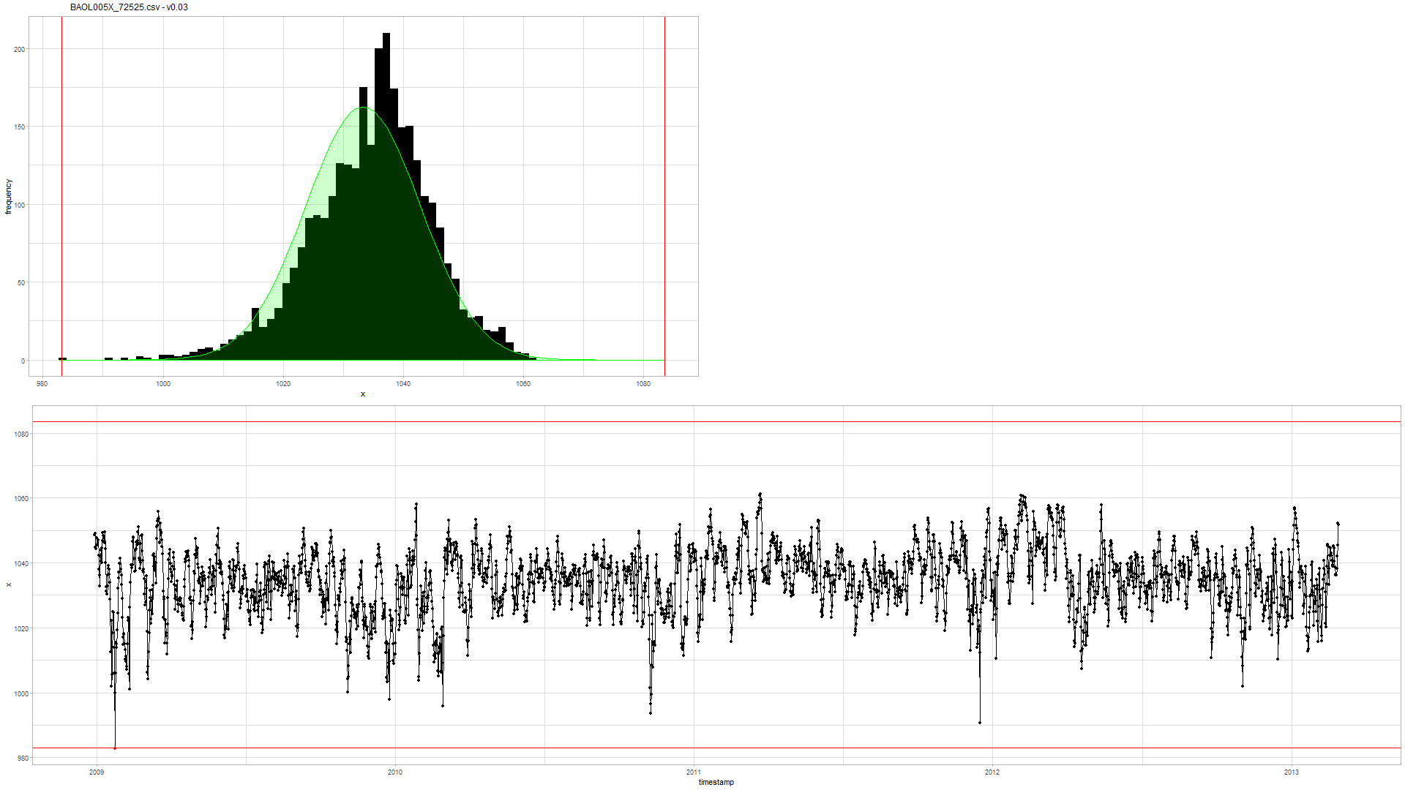

Example (BAOL005X_72525) v0.03 (new) vs. v0.02 (old)
Notes:
Rechts: oude v0.02: eerste punt is geen outlier
Links: nieuwe v0.03: is outlier

Slide 32
Logger
Universal data loading

Slide 33
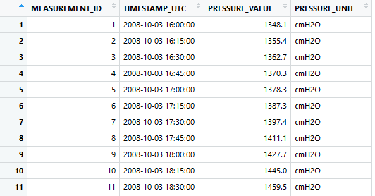
Uniform data loading: Logger object
Todo… VMM.
Static methods:
Logger::enumerate(partner = 'inbo')
Logger::enumerate(partner = 'geotech’)
Initialization:
df <- Logger('DYLP006X')$df
df <- Logger('ff_b29d_0903')$df
Uniform dataframe:
Primary key: MEASUREMENT_ID
UTC timestamp: TIMESTAMP_UTC
Value: PRESSURE_VALUE
Units: PRESSURE_UNIT
Notes:
Bedoeling is dat hier ook VMM data op een gelijkaardige manier wordt geladen.

Slide 34
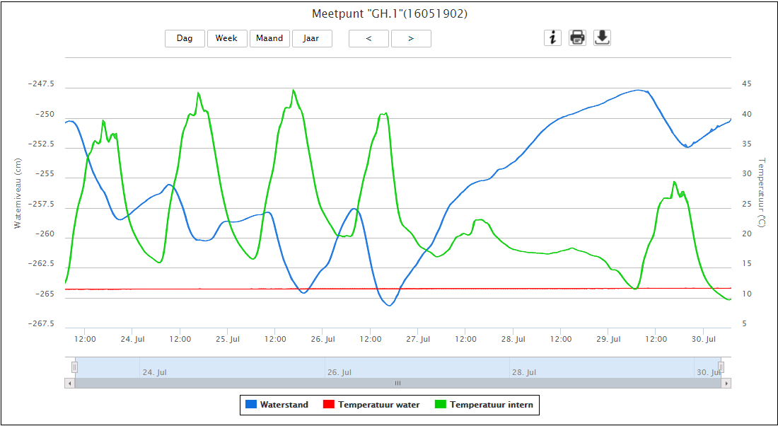
VMM raw data?
http://www.ellitrack.nl/tracker/

Slide 35
Geotechniek
Outliers

Slide 36
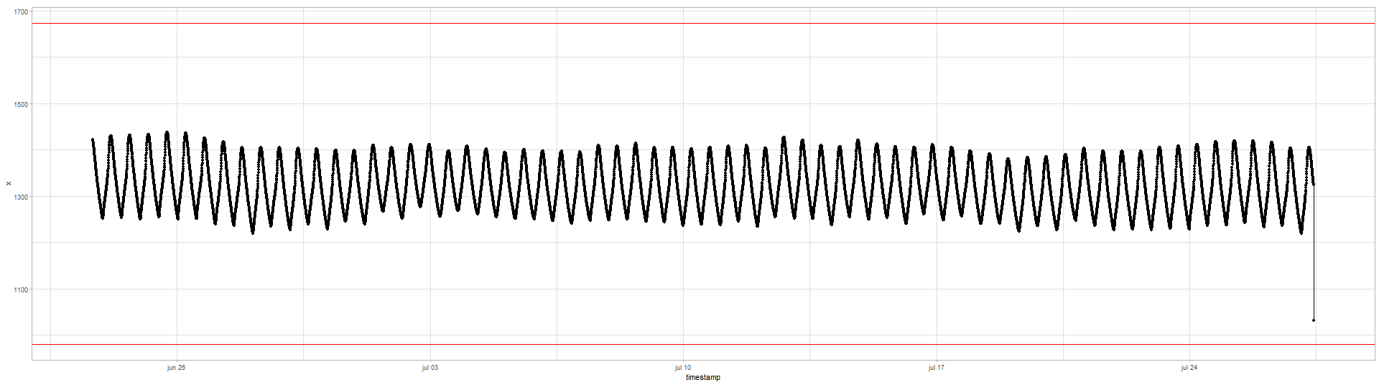
Quick exploration
All data have timestamps without NA
Time intervals are either 5 or 15min:
5 min 15 min 1307676 436567
If necessary: best to aggregate on hourly basis?
The data is clearly seasonal and a random walk

Slide 37
Geotech outlier comparison
Main comparison file:
https://github.com/DOV-Vlaanderen/groundwater-logger-validation/blob/levelshifts/src/r/outliers/outliers_comparison_geotech.pdf
5 methods
v0.01: normality assumption
v0.02: upper level = apriori air pressure, lower level normality assumption
v0.04: based on apriori difference min(left-diff, right-diff) knowledge:
5min: max 10cmH2O
tsoutliers:
Full: AO, TC, LS
AO only highlights with difference plot

Slide 38
tsoutliers --> AO
v0.01
v0.02
v0.04
tsoutliers --> AO, TC, LS

Slide 39
Geotech outlier comparison: v0.01
Data not normal but a seasonal random walk.

Slide 40
Geotech outlier comparison: v0.01
Sometimes it works, but mostly not…

Slide 41
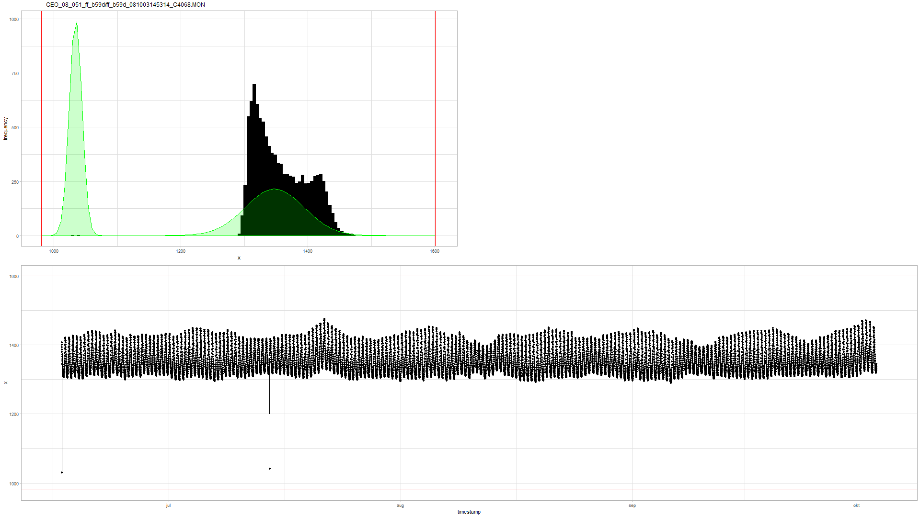
Geotech outlier comparison: v0.02
Similar to v0.01…

Slide 42
Geotech outlier comparison: v0.02
In the air…
“valid data”
Notes:
Voordeel is dus dat je gemakkelijk kan zien of de data wel “valid is” … maar daar stopt het wel.

Slide 43
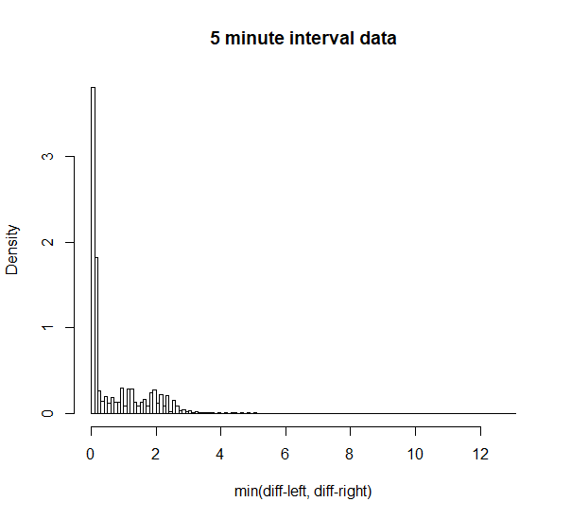
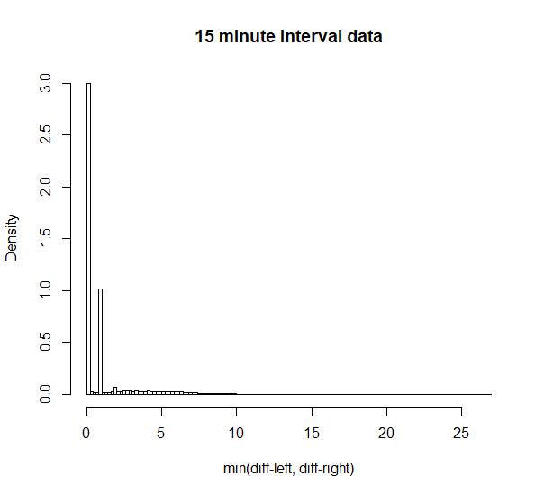
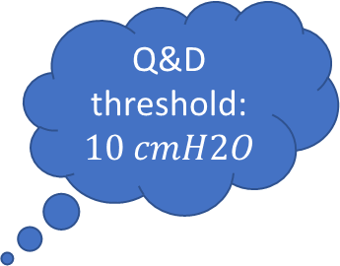

Geotech outlier comparison: v0.04
Q&D threshold: $10 cmH2O$
Q&D threshold: $30 cmH2O$
Notes:
Treshold: 10 and 30 cmH2O

Slide 44
Geotech outlier comparison: v0.04
Detected… (cf. v0.01 not detected)

Slide 45
Geotech outlier comparison: v0.04
Detected… (cf. v0.01 not detected)

Slide 46
Geotech outlier comparison: v0.04
Detected… (cf. tsoutliers not detected due to aggregation)

Slide 47
Geotech outlier comparison: v0.04
Detected… (cf. tsoutliers not detected due to last point or agg.)

Slide 48
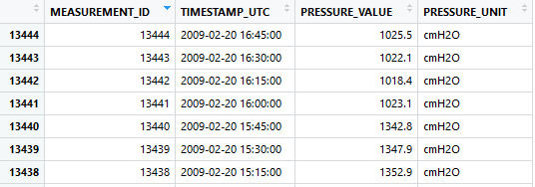
Geotech outlier comparison: v0.04
Missed due to multiple points. Level shift?

Slide 49
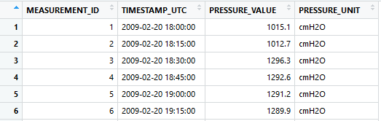
Geotech outlier comparison: v0.04
Also missed.
Level shift?

Slide 50
Geotech outlier comparison: tsoutliers
tsoutliers found it. Wrong point??

Slide 51
Geotech outlier comparison: tsoutliers
Weird… (v0.04 detects nothing)

Slide 52
tsoutliers detects two outliers? v0.04 nothing

Slide 53
Only v0.04 detected…

Slide 54
tsoutliers detects level shifts also…

Slide 55
tsoutliers aggregates: how to extract 1 single point.
Notes:
Omwille van aggregatie op uur ziet de tsoutlier plot er lichtjes anders uit.

Slide 56
Geotech outlier comparison: conclusion
v0.01 and v0.02
Normality assumption doesn’t apply to hydrostatic pressure.
v0.02 could be used to assess validity of data.
tsoutliers
Sometimes detects weird AO’s due to auto.arima model.
Slow: +10h on pp09-2_120829131517_F8511, pp08-2_120829135933_F8503, ff_b51d_090429160102_C4089
Aggregation required --> makes outlier detection and extraction of 1 point difficult.
Biggest strength is LS detection.
Personal note: we should be able to make something better.
v0.04
Is intelligible and fast.
Has no problems with first point and last point being outliers.
Is good in detecting 1 point outliers.
Has problems with > 1 point sequential outliers --> level shift?
Has best potential for outlier detection?

Slide 57
Level shifts: summary
Suggestion:
Reference algorithm (for comparison): tsoutliers
A custom approach…

Slide 58
Level shift?
Notes:
Omwille van aggregatie op uur ziet de tsoutlier plot er lichtjes anders uit.

Slide 59
No level shift?
Notes:
Omwille van aggregatie op uur ziet de tsoutlier plot er lichtjes anders uit.

Slide 60
Multiple level shifts?

Slide 61
Clear level shift.

Slide 62
Clear short level shift and outlier.

Slide 63
Next steps

Slide 64
Next steps
VMM data?
Focus on intelligible models vs. tsoutliers?
In case of outlier detection: you know “why”.
Improve and implement v0.04?
Level shifts
Improve tsoutliers (i.e. detect only large level shifts)
Make diagnostic plots for level shifts.
Custom approach…?

Slide 65
The End

Slide 66
Sprint 3
Level shifts

Slide 67
Agenda
Outliers
Level shifts
strucchange package
tsoutliers package
rank-based shift detection
Timestamps
Data aggregation
gwloggeR v0.1.2

Slide 68
Outliers
Recap

Slide 69
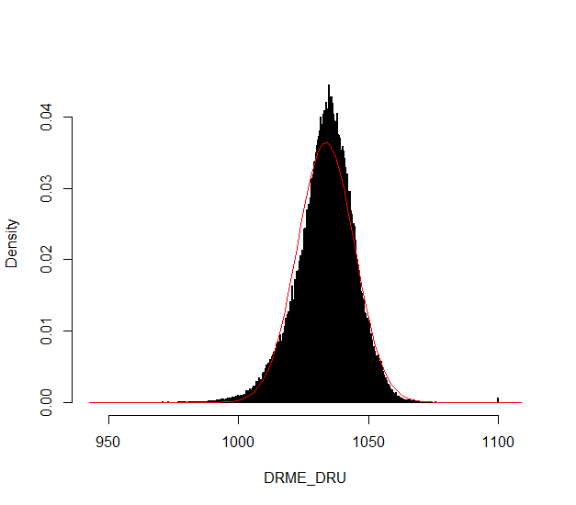
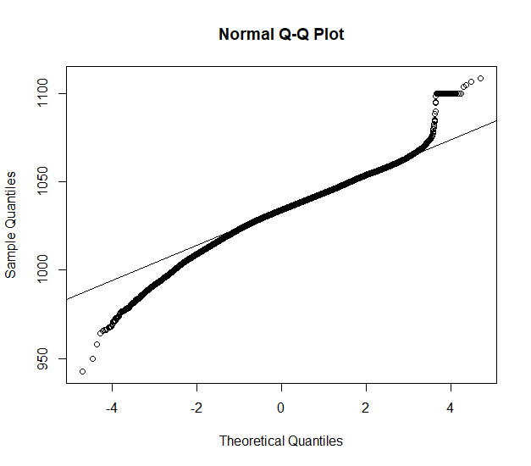
Outliers: v0.02
Validation
Excluded: BAOL089|BAOL079|BAOL006 (mBar)
Range: 800 < x < 1200
Notes:
Excluded: BAOL089|BAOL079|BAOL006
Range: 800 < x < 1200

Slide 70
Outliers: v0.02 example detect_outliers(x, apriori("air pressure", "cmH2O"))

Slide 71
Outliers: v0.02
Next steps
Build kernel based on clean data
Simulation test: verify power
Document in detail
Notes:
Excluded: BAOL089|BAOL079|BAOL006
Range: 800 < x < 1200

Slide 72
Level Shifts
strucchange
tsoutliers
rank-based

Slide 73
strucchange package
For modeling changes in mean

Slide 74
Level shift?

Slide 75
Strucchange package

Slide 76
Strucchange package
Pros:
Detects changes in a linear model (e.g. intercept only linear regression)
Mature package
Speed: 5 min average
Cons:
No ARIMA support
Uses lots of memory (+5GB on some cases)

Slide 77
tsoutliers package
For modeling level shifts with ARIMA models

Slide 78
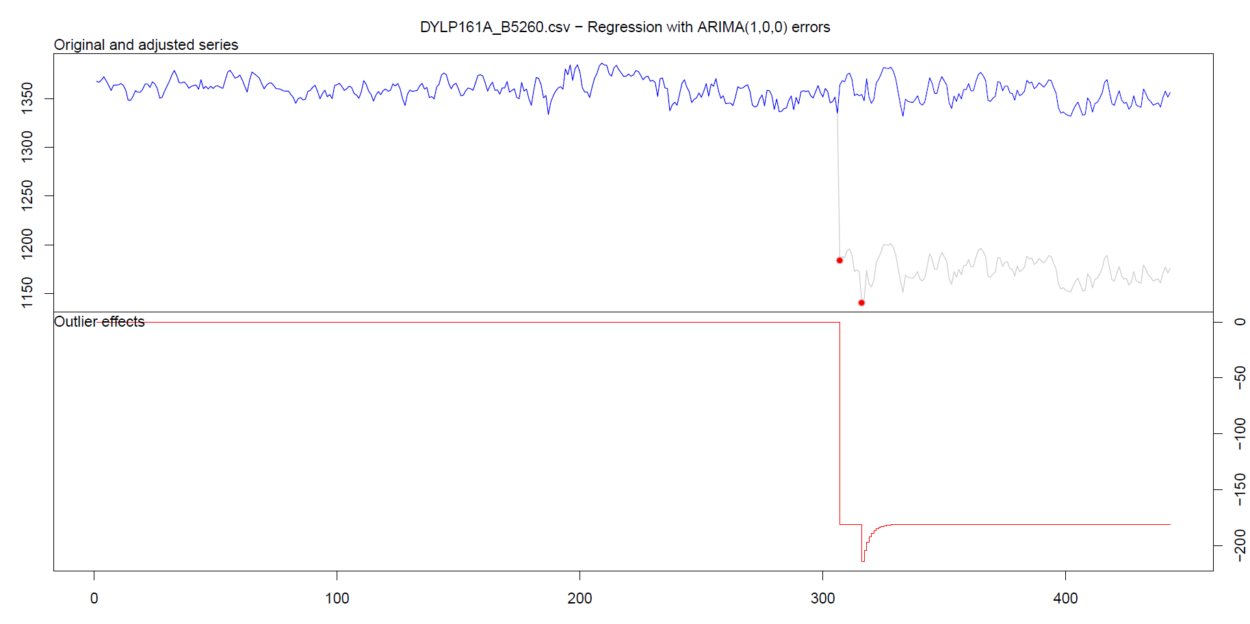
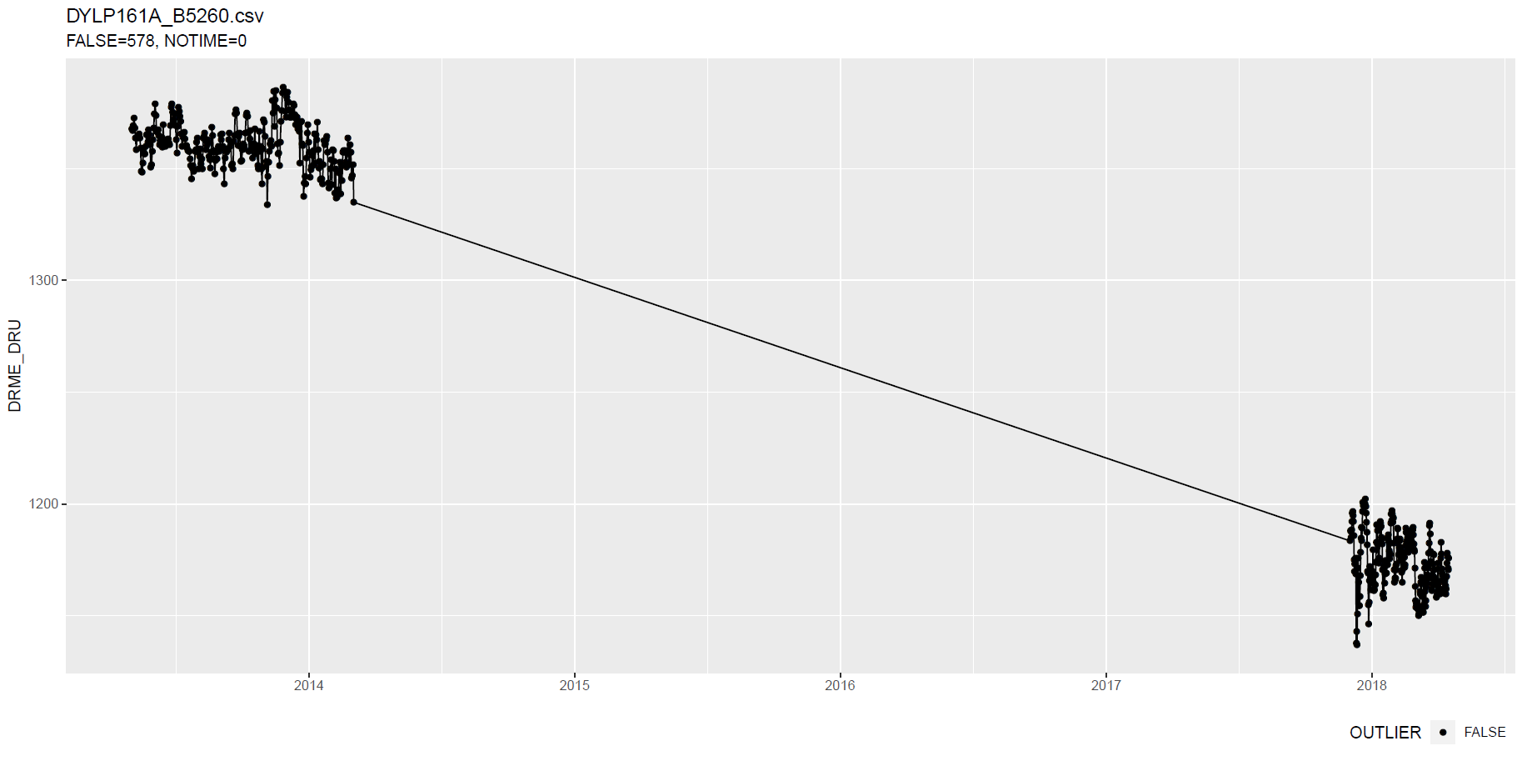
tsoutliers package
Notes:
Wat hier ook kan zijn, is dat intussentijd de situatie gewoon geleidelijk is gewijzigd: dus niet abrupt.

Slide 79
tsoutliers package
Notes:
Wat hier ook kan zijn, is dat intussentijd de situatie gewoon geleidelijk is gewijzigd: dus niet abrupt.

Slide 80
tsoutliers package
Notes:
Wat hier ook kan zijn, is dat intussentijd de situatie gewoon geleidelijk is gewijzigd: dus niet abrupt.

Slide 81
tsoutliers package
More cases: see here.

Slide 82
tsoutliers package
Pros:
Allows for a wide range of ARIMA-based models
Seems to detect LS well
Speed: 10 min average with aggregation
Cons:
Can not be used without aggregation (for >5k points)
Package is still in development

Slide 83
Rank-based shift detection
For modeling level shifts with rank-based statistics

Slide 84
Rank based level shift detection
Fried, R. e.a., On rank tests for shift detection in time series, 2007
Bovik, A.C. e.a., Nonparametric Tests for Edge Detection in Noise, 1986
Based on the distribution of a test statistic (e.g. Wilcoxon statistic) the normal situation can be defined. Based on this definition, exceptional shift situations could be detected.
Pro: speed!

Slide 85
Defining Level Shift
Discussion

Slide 86
Level shift?

Slide 87
Level shift?
Notes:
Lots of missing data!!

Slide 88
Level shift?
Notes:
Lots of missing data!!

Slide 89
Level shift?

Slide 90
Level shift?

Slide 91
Level shift?
Notes:
2 shifts?

Slide 92
Level shift?
Notes:
Is rood een flat line?

Slide 93
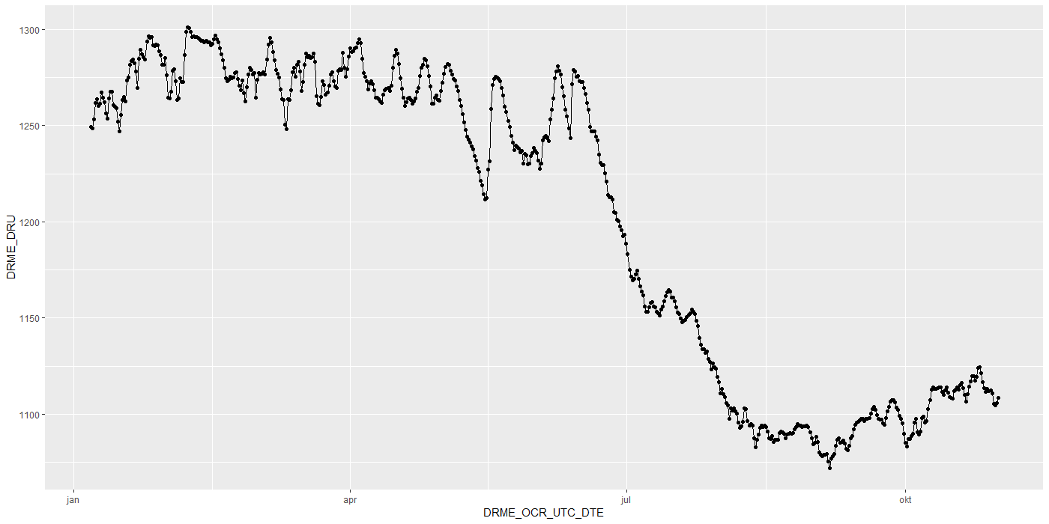
Level shift?

Slide 94


Level shift?

Slide 95
Level shift?

Slide 96
Level shift: tsoutliers

Slide 97

Level shift?
Notes:
Is rood een flat line?

Slide 98

Level shift?
?
Notes:
Is rood een flat line?

Slide 99

Level shift?
Notes:
Is rood een flat line?

Slide 100
Timestamps

Slide 101

Timestamps: varying time-difference between observations (BAOL068X_180816.csv)
Sometimes 11, 12 or 13 hours
Notes:
BAOL068X_180816.csv

Slide 102
Timestamps: varying time-difference between observations
Equidistant observations are important for ARIMA-like timeseries models.
Without equidistance, the usability of ARIMA is limited.
Example: Differencing
For small time-differences: measured differences determined by sensor inaccuracy
For large time-differences: measured differences determined by sensor inaccuracy and atmospheric changes.
Timestamps: Take into account all kinds of scenarios?

Slide 103
Importance
Visualization:
Its either TIMESTAMP or SEQUENCE
INBO:
Can make sure that timestamp is always available.
Other parties?

Slide 104
gwloggeR
Change log
Feedback?

Slide 105
Change log
“Diver” → “hydrostatic pressure”
ap <- apriori("hydrostatic pressure", "cmH2O")
detect_outliers(x, apriori = ap)
detect_duplicates(ts)

Slide 106
Aggregation function
Lump together and take average.
Other (better?) ways?

Slide 107
Next steps

Slide 108
Next steps
Outliers v0.02
Build kernel based on clean data
Simulation test: verify power
Document in detail
Level shifts:
Gather more Level Shift examples
Better visualization
“Nederlanders”?

Slide 109
Hysteresis?

Slide 110
The End

Slide 111
Sprint 2
Outliers

Slide 112
Agenda
DRME_DMST_CDE validation
Outliers: v0.02 update
Comparison v0.01 vs v0.02
gwloggeR v0.1.1
Assessment
anomalize
tsoutliers

Slide 113
DRME_DMST_CDE
Flags from DB: ENT (entered); DEL (deleted) and INV (invalid).

Slide 114
DRME_DMST_CDE
On all *.csv-data:
DEL ENT INV VLD <NA>
462 556271 4697 16 0

Slide 115
DRME_DMST_CDE: VLD and DEL
PPNT_ID PPNT_CDE DRSO_ID DRSO_SER_NBR DRME_ID DRME_OCR_UTC_DTE DRME_DRU DRME_TPU DRME_DMTP_CDE DRME_DMST_CDE SEQUENCE
1: 7019 BAOL001X 275 D0939 238389 2010-11-11 10:00:00 1018.100 NA LDME VLD 1093
2: 7019 BAOL001X 275 D0939 1824560 2010-11-11 10:00:00 1018.075 6.033 LDME ENT 1130
3: 7019 BAOL001X 275 D0939 238390 2010-11-11 22:00:00 1007.300 NA LDME VLD 1094
4: 7019 BAOL001X 275 D0939 1824561 2010-11-11 22:00:00 1007.275 8.163 LDME ENT 1131
5: 7019 BAOL001X 275 D0939 238391 2010-11-12 10:00:00 1015.400 NA LDME VLD 1095
6: 7019 BAOL001X 275 D0939 1824562 2010-11-12 10:00:00 1015.375 11.213 LDME ENT 1132
7: 7019 BAOL001X 275 D0939 238392 2010-11-12 22:00:00 1012.900 NA LDME VLD 1096
8: 7019 BAOL001X 275 D0939 1824563 2010-11-12 22:00:00 1012.850 12.457 LDME ENT 1133
9: 7019 BAOL001X 275 D0939 238393 2010-11-13 10:00:00 1014.600 NA LDME VLD 1097
10: 7019 BAOL001X 275 D0939 1824564 2010-11-13 10:00:00 1014.600 10.810 LDME ENT 1134
11: 7019 BAOL001X 275 D0939 238394 2010-11-13 22:00:00 1012.700 NA LDME VLD 1098
12: 7019 BAOL001X 275 D0939 1824565 2010-11-13 22:00:00 1012.675 10.953 LDME ENT 1135
Duplicates: Detect those too?
Notes:
Duplicaten in de DB?

Slide 116
DRME_DMST_CDE: INV
Validation

Slide 117
DRME_DMST_CDE: INV
Validation

Slide 118

DRME_DMST_CDE: INV
Validation
No Timestamp (Inconsistent)
No Timestamp: Detect those too?
Notes:
Inconsistent because there are also black dots that have no timestamp.

Slide 119
Outliers: v0.02 update
Uses simple a-priori knowledge about air pressure, temperature, etc.

Slide 120
Outliers: v0.02 update
Validation
Excluded: BAOL089|BAOL079|BAOL006 (mBar)
Range: 800 < x < 1200
Notes:
Excluded: BAOL089|BAOL079|BAOL006
Range: 800 < x < 1200

Slide 121
Outlier comparison
v0.01, v0.02, DRME_DMST_CDE

Slide 122
Outlier comparison

Slide 123
Outlier comparison

Slide 124
Outlier comparison

Slide 125
Outlier comparison

Slide 126
Outlier comparison

Slide 127
Outlier comparison

Slide 128
Outlier comparison

Slide 129
Outlier comparison

Slide 130
tsoutliers package

Slide 131

tsoutliers package
auto.arima(Nile)
Series: Nile
ARIMA(1,1,1)
Coefficients:
ar1 ma1
0.2544 -0.8741
s.e. 0.1194 0.0605
sigma^2 estimated as 19769: log likelihood=-630.63
AIC=1267.25 AICc=1267.51 BIC=1275.04
nile.outliers <- tso(Nile,types = c("AO","LS","TC"))
nile.outliers
Series: Nile
ARIMA(0,0,0) with non-zero mean
Coefficients:
intercept LS29 AO43
1097.7500 -242.2289 -399.5211
s.e. 22.6783 26.7793 120.8446
sigma^2 estimated as 14401: log likelihood=-620.65
AIC=1249.29 AICc=1249.71 BIC=1259.71
Outliers:
type ind time coefhat tstat
1 LS 29 1899 -242.2 -9.045
2 AO 43 1913 -399.5 -3.306
Notes:
https://stats.stackexchange.com/questions/104882/detecting-outliers-in-time-series-ls-ao-tc-using-tsoutliers-package-in-r-how

Slide 132
tsoutliers package: AO’s

Slide 133
tsoutliers package: AO’s

Slide 134
tsoutliers package: AO’s
WRONG
TIMESTAMPS NOT SEQUENTIAL
Notes:
Afstandedn veel groter sinds 2018

Slide 135

tsoutliers package
Pros:
Formalism
Integration with (S)ARIMA
Cons:
Speed? (+12h on BAOL033X_C6550.csv)
Ad-hoc (messy) solution
ToDo:
Simulations for validation
Visualization of AO, LS en TC outliers
Think it best works with “all” outliers enabled.
Notes:
Zou best

Slide 136
anomalize package

Slide 137

anomalize package
vs. tsoutliers
Notes:
Same Nile dataset

Slide 138
anomalize package
Pros:
Straightforward and fast timeseries decomposition
Cons:
Only AO
LS and TC can not be specified
Not backed by decent theory
Notes:
Zou best

Slide 139
gwloggeR
Feedback?

Slide 140
Next steps

Slide 141
Next steps
Define control vocabulary?
Suggested function output:
?
Notes:
temporal change : multiple points after the change should be “red”
Level shifts: how to flag those?

Slide 142
Next steps
Go further with tsoutliers
Visualisation: level shift (LS)
Simulations
Give a better idea of model performance for specific cases
Examples:
ARIMA(0,0,0) with AO
ARIMA(0,0,0) with LS
etc.
gwloggeR versioning?
Notes:
temporal change : multiple points after the change should be “red”
Level shifts: how to flag those?

Slide 143
The End

Slide 144
Sprint 1
Outliers

Slide 145
Outliers
v0.01: detect_outliers(data)
Uses only the supplied dataset
v0.02: detect_outliers(data, type = c(“air pressure”, “air temperature”), units)
Uses simple a-priori knowledge about air pressure, temperature, etc.
v0.03: …

Slide 146
Outliers: v0.01
Uses only the supplied dataset

Slide 147
Outliers: v0.01
Validation

Slide 148
Outliers: v0.01
Validation

Slide 149
Outliers: v0.01
Validation

Slide 150
Outliers: v0.01
Validation

Slide 151
Outliers: v0.01
Validation

Slide 152
Outliers: v0.01
Validation

Slide 153
Outliers: v0.01
Validation

Slide 154
Outliers: v0.01
Validation
Scale completely wrong?

Slide 155
Outliers: v0.02
Uses simple a-priori knowledge about air pressure, temperature, etc.

Slide 156


Outliers: v0.02
Validation

Slide 157
Outliers: v0.02
Validation

Slide 158
Outliers: v0.02
Validation

Slide 159
Outliers: v0.02
Validation

Slide 160
Summary
Outliers: v0.01
detect_outliers(data)
Usable on any data (not only L - lucht)
Scale can be completely wrong (cf. BAOL018X_42112)
Outliers: v0.02:
detect_outliers(data, type = c(“air pressure”, “air temperature”), units)
Needs a-priori information
Type
Units
Fixed or dynamic thresholds?
Notes:
Tresholds voor outliers kunnen berekend worden op basis van handmatige prior analyse, of

Slide 161
Outliers: v0.03
Go even further with a-priori information?

Slide 162

Outliers: v0.03
Even more a-priori information to explain variation
Notes:
Bijvoorbeeld, somige regio’s hebben lagere of hogere temperature, wat resulteert in hogere of lagere luchtdruk.

Slide 163

Outliers: v0.03
Model for pressure based on Bernoulli’s equation:
$$P+\frac{1}{2}ρv^{2}+ρgh=constant$$
$h$
$ρ$ depends on:
Temperature (significant)
Moisture?
$v$ depends on:
Pressure (i.e. circular, so shouldn’t have any effect?)

Slide 164

Outliers: v???
First order difference: very long tails
Notes:
Very long tails, not normal

Slide 165
Next steps

Slide 166
Next steps
Make first version of package with outlier detector 0.01 and 0.02?
If no extra data supplied, use v0.01, else v0.02?
v0.02: fixed or dynamic thresholds?
Other ideas?
Notes:
Misschien best om zo snel mogelijk met package te beginnen: dan kan gebruik meteen geevalueerd worden.

Slide 167
The End

